Slide 1
The Chain Rule

Slide 2
Outline
Derivatives
The Chain Rule

Slide 3

Derivatives
A derivative in calculus is the rate of change of a quantity $y$ with respect to another quantity $x$

Slide 4
Imagine that we collected these measurements from four persons

Slide 5
On the x-axis, we measured their Weight.
And in the y-axis, we measured their Blood Pressure
Blood Pressure
Weight

Slide 6
We can fit this parabola to the data
Blood Pressure
Weight

Slide 7

The equation for a parabola is…
$$Blood pressure= {\left(Weight\right)}^{2}$$
Blood Pressure
Weight

Slide 8

The derivative of this equation tells us the slope of the tangent line at any point along the curve
$$Blood pressure= {\left(Weight\right)}^{2}$$
Blood Pressure
Weight

Slide 9
The derivative of this equation tells us the slope of the tangent line at any point along the curve
$$Blood pressure= {\left(Weight\right)}^{2}$$
Blood Pressure
Weight

Slide 10
The derivative of this equation tells us the slope of the tangent line at any point along the curve
$$Blood pressure= {\left(Weight\right)}^{2}$$
Blood Pressure
Weight

Slide 11
The derivative of this equation tells us the slope of the tangent line at any point along the curve
$$Blood pressure= {\left(Weight\right)}^{2}$$
Blood Pressure
Weight

Slide 12
The derivative of this equation tells us the slope of the tangent line at any point along the curve
$$Blood pressure= {\left(Weight\right)}^{2}$$
Blood Pressure
Weight

Slide 13
The slope of the tangent line tells us how quickly Blood pressure is changing with respect to Weight
$$Blood pressure= {\left(Weight\right)}^{2}$$
Blood Pressure
Weight

Slide 14

We can calculate the derivative of Blood Pressure with respect to Weight by using the Power Rule
$$Blood pressure= {\left(Weight\right)}^{2}$$
Blood Pressure
$$\frac{d Blood Pressure}{d Weight}$$
Weight

Slide 15
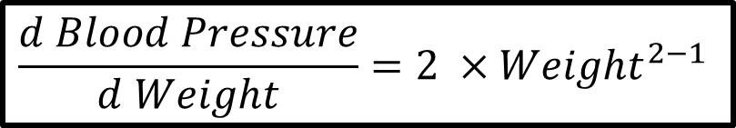
The Power Rule tells us to multiply Weight by the power, which is 2 and raise Weight by the power of 2 minus 1
$$Blood pressure= {\left(Weight\right)}^{2}$$
Blood Pressure
$$\frac{d Blood Pressure}{d Weight}=2 ×{Weight}^{2−1}$$
Weight

Slide 16

Since $2−1=1$ and raising something by 1 is the same as omitting the power…
$$Blood pressure= {\left(Weight\right)}^{2}$$
Blood Pressure
$$\frac{d Blood Pressure}{d Weight}=2 ×{Weight}^{2−1}$$
Weight

Slide 17
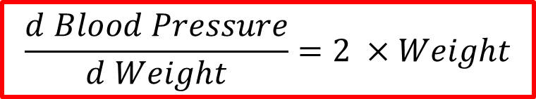
We end up with 2 times Weight
$$Blood pressure= {\left(Weight\right)}^{2}$$
Blood Pressure
$$\frac{d Blood Pressure}{d Weight}=2 ×Weight$$
Weight

Slide 18
Let use another example.
Imagine we collected Weight and Height measurements from 3 people
Height
Weight

Slide 19
And then we fit a line to the data.
Height
Weight

Slide 20

If someone weighs this much
Height
Weight

Slide 21
We can use the green line to predict that they are this tall
Height
Weight

Slide 22
We can use the green line to predict that they are this tall
Height
Weight

Slide 23
Height
Shoe size
Weight
Height
Now imagine we collected Height and Shoe size measurements

Slide 24
Height
Shoe size
Weight
Height
And we fit a line to the data

Slide 25
Height
Shoe size
Weight
Height
Now if someone tells us that they are this tall…

Slide 26
Height
Shoe size
Weight
Height
We can use the orange line to predict their Shoe size

Slide 27
Height
Shoe size
Weight
Height
Now if someone tells us that they weigh this much

Slide 28
Height
Shoe size
Weight
Height
Then we can predict their Height

Slide 29
Height
Shoe size
Weight
Height
And we can use the predicted Height

Slide 30
Height
Shoe size
Weight
Height
To predict Shoe size

Slide 31
Height
Shoe size
Weight
Height
And if we change the value of Weight, we see a change in Shoe size

Slide 32
Height
Shoe size
Weight
Height
And if we change the value of Weight, we see a change in Shoe size

Slide 33
Height
Shoe size
Weight
Height
And if we change the value of Weight, we see a change in Shoe size

Slide 34
Height
Shoe size
Weight
Height
And if we change the value of Weight, we see a change in Shoe size

Slide 35
Height
Shoe size
Weight
Height
And if we change the value of Weight, we see a change in Shoe size

Slide 36
Height
Shoe size
Weight
Height
Now let us focus on this green line that represents the relationship between Height and Weight

Slide 37
Height
Shoe size
2
1
Weight
Height
We see that for every 1 unit increase in Weight, there is a 2 unit increase in Height

Slide 38
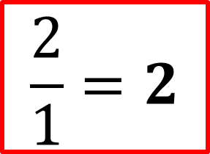
Height
Shoe size
2
1
Weight
Height
In other words, the slope of the green line is
$$\frac{2}{1}=2$$

Slide 39
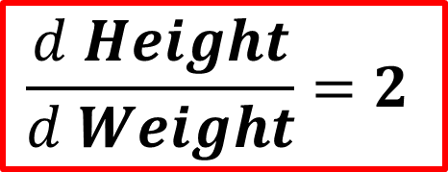
Height
Shoe size
2
1
Weight
Height
And since the slope is 2, the derivative , the change in Height with respect to change in Weight is also 2
$$\frac{d Height}{d Weight}=2$$

Slide 40

Height
Shoe size
2
1
Weight
Height
Now, since the slope of the green line is the same as its derivative
$$\frac{d Height}{d Weight}=2$$

Slide 41
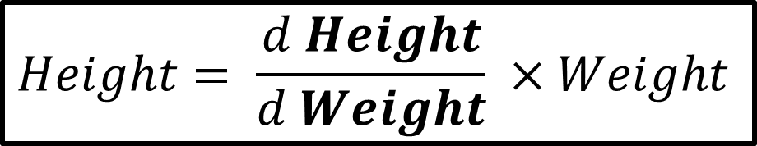

Height
Shoe size
2
1
Weight
Height
The equation for Height is…
$$Height= \frac{d Height}{d Weight} ×Weight$$
$$Height=2×Weight$$

Slide 42
Height
Shoe size
Weight
Height
Now, let us focus on the orange line that represents the relationship between Height and Shoe size

Slide 43


Height
Shoe size
$$\frac{1}{4}$$
1
Weight
Height
In this case, we see that for every 1 unit increase in Height, there is a $1/4$ increase in Shoe size

Slide 44

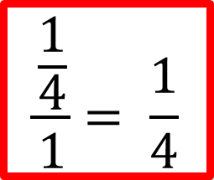
Height
Shoe size
$$\frac{1}{4}$$
1
Weight
Height
Because we go up $\frac{1}{4}$ for every 1 unit we go over, the slope is
$$\frac{\frac{1}{4}}{1}= \frac{1}{4}$$

Slide 45
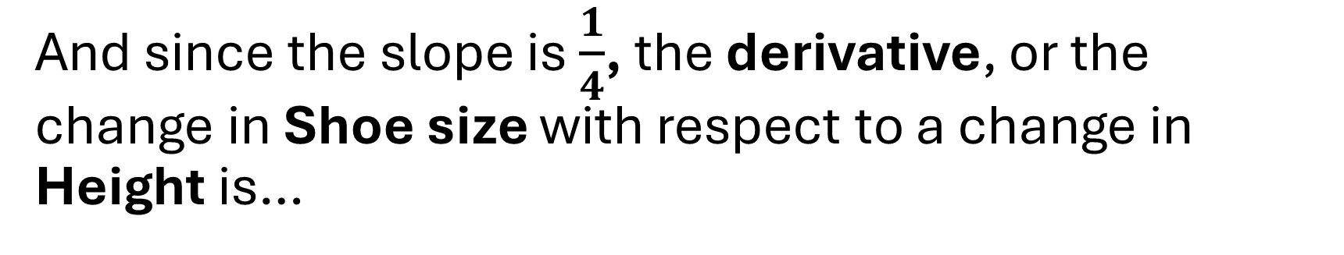
Height
Shoe size
$$\frac{1}{4}$$
1
Weight
Height
And since the slope is $\frac{1}{4}$, the derivative, or the change in Shoe size with respect to a change in Height is…

Slide 46
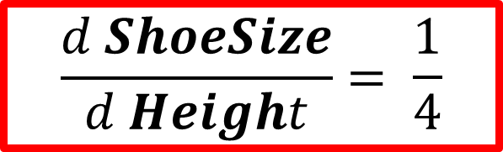
Height
Shoe size
$$\frac{1}{4}$$
1
Weight
Height
$$\frac{d ShoeSize}{d Height}= \frac{1}{4}$$

Slide 47

Height
Shoe size
$$\frac{1}{4}$$
1
Weight
Height
Since the slope is of the orange line is the same as its derivative, $\frac{1}{4}$

Slide 48


Height
Shoe size
$$\frac{1}{4}$$
1
Weight
Height
The equation for Shoe size is…
$$Shoe Size=\frac{d ShoeSize}{d Height} ×Height$$
$$Shoe Size=\frac{1}{4} ×Height$$

Slide 49




Now, because Weight can predict Height
$$Height=\frac{d Height}{d Weight} ×Weight$$
$Height=2 ×Weight$
And Height can predict Shoe Size
$$Shoe Size=\frac{d ShoeSize}{d Height} ×Height$$
$$Shoe Size=\frac{1}{4} ×Height$$

Slide 50



We can plug the equation for Height into the equation for Shoe size
$$Height=\frac{d Height}{d Weight} ×Weight$$
$$Shoe Size=\frac{d ShoeSize}{d Height} ×Height$$
$$Shoe Size=\frac{d ShoeSize}{d Height} ×\frac{d Height}{d Weight} ×Weight$$

Slide 51
Height
Shoe size
Weight
Height
Now if we want to determine exactly how Shoe Size changes with respect to changes in Weight

Slide 52

Height
Shoe size
Weight
Height
We take the derivative of Shoe Size with respect to Weight
$$\frac{d ShoeSize}{d Height}$$

Slide 53


And the derivative of the equation for Shoe Size with respect to Weight
$$Shoe Size=\frac{d ShoeSize}{d Height} ×\frac{d Height}{d Weight} ×Weight$$
Is just the product of the two derivatives
$$\frac{d ShoeSize}{d Weight} =\frac{d ShoeSize}{d Height} ×\frac{d Height}{d Weight}$$

Slide 54
Height
Shoe Size
Weight
Height
In other words, because Height connects Weight to Shoe Size

Slide 55
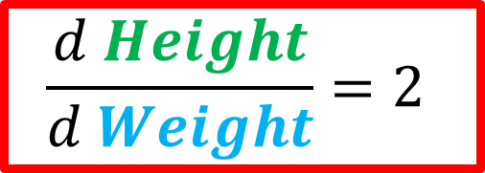

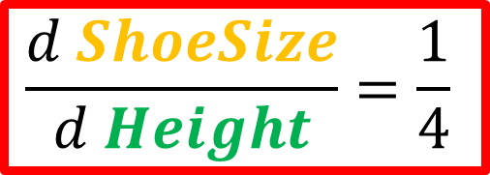
The derivative of Shoe Size with respect to Weight
$$\frac{d ShoeSize}{d Weight} =\frac{d ShoeSize}{d Height} ×\frac{d Height}{d Weight}$$
Is the derivative of Shoe Size with respect to Height times the derivative of Height with respect to Weight
$$\frac{d ShoeSize}{d Height}=\frac{1}{4}$$
$$\frac{d Height}{d Weight}=2$$

Slide 56
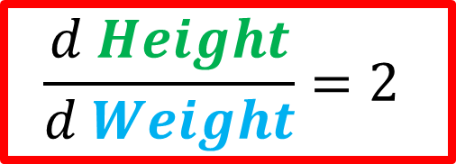


This relationship is the essence of the Chain Rule
$$\frac{d ShoeSize}{d Weight} =\frac{d ShoeSize}{d Height} ×\frac{d Height}{d Weight}$$
$$\frac{d ShoeSize}{d Height}=\frac{1}{4}$$
$$\frac{d Height}{d Weight}=2$$

Slide 57
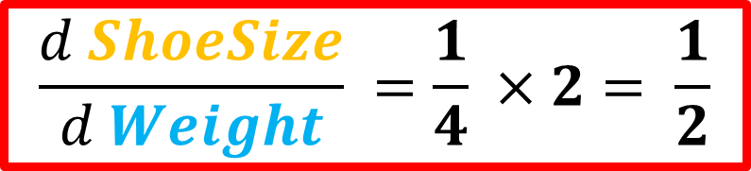



$$\frac{d ShoeSize}{d Weight} =\frac{d ShoeSize}{d Height} ×\frac{d Height}{d Weight}$$
$$\frac{d Height}{d Weight}=2$$
$$\frac{d ShoeSize}{d Height}=\frac{1}{4}$$
Plugging in the numbers give us….
$$\frac{d ShoeSize}{d Weight} =\frac{1}{4} ×2= \frac{1}{2}$$

Slide 58



Height
Shoe Size
2
$$\frac{1}{2}$$
1
2
Weight
Height
And that means, for every 1 unit increase in Weight, there is a $\frac{1}{2}$ unit increase in Shoe Size.
$$\frac{d ShoeSize}{d Weight} =\frac{1}{4} ×2= \frac{1}{2}$$

